Slide 1
Sprite & DirectInput programming

Slide 2
Objectives
Create animated objects
Access keyboard with DirectInput

Slide 3
References
Beginning Game Programming
  Chapter 7, 8 - 10

Slide 4
Sprite programming

Slide 5
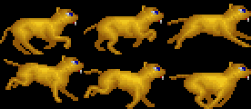
What is sprite?
A sprite is a two-dimensional image or animation that is integrated into a larger scene. (Wikipedia)

Slide 6
Surface for background
Init
  D3DXGetImageInfoFromFile
  CreateOffscreenPlainSurface
  D3DXLoadSurfaceFromFile
Render
  D3DDEVICE9::StretchRect

Slide 7
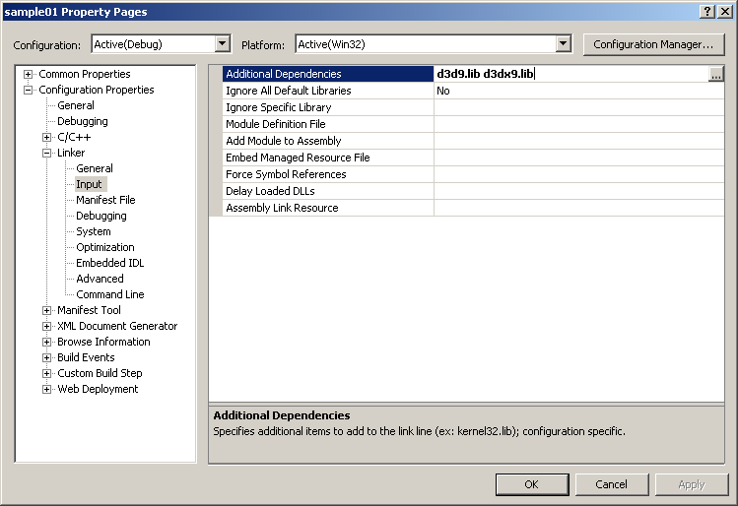
D3C Helper library (D3DX)
#include <d3dx9.h>

Slide 8
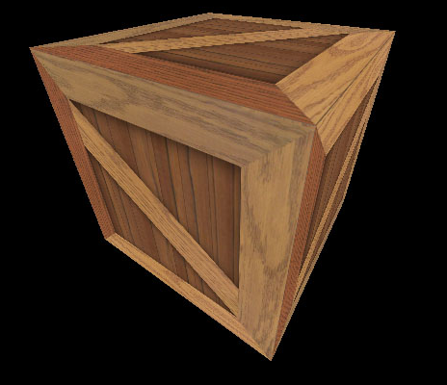
What is texture?
An image that “covers” the surface of polygons of a 3D model to make it looks more real.

Slide 9
Transparent sprite
Init
  D3DXCreateSprite: to create handler
  D3DXGetImageInfoFromFile: to get width, height
  D3DXCreateTextureFromFileEx
Render
  LPD3DXSPRITE::Begin
  LPD3DXSPRITE::Draw
  LPD3DXSPRITE::End

Slide 10
A sprite class
To handle sprites within a large bitmap

Slide 11
A sprite class
class Sprite {
protected:
LPDIRECT3DTEXTURE9 _Image; // The “container”
LPD3DXSPRITE _SpriteHandler;
int _Index; // Current sprite index
int _Width; // Sprite width
int _Height; // Sprite height
int _Count; // Number of sprites in the container
int _SpritePerRow; // Number of sprites per row
public:
Sprite::Sprite(LPD3DXSPRITE SpriteHandler, char *Path, int Width, int Height, int Count, int SpritePerRow);
// Advance to next sprite in the list
void Next();
// Render current sprite at location (X,Y) at the target surface
void Render(LPDIRECT3DSURFACE9 Target, int X, int Y);
~Sprite();
};

Slide 12
A sprite class
_SpritePerRow = 3
_Width
_Height
_Count = 6

Slide 13
A sprite class
Sprite::Sprite(
LPD3DXSPRITE SpriteHandler, char *Path, int Width, int Height,
int Count, int SpritePerRow) {
D3DXIMAGE_INFO info;
HRESULT result;
_Image = NULL;
_SpriteHandler = SpriteHandler;
_Width = Width;
_Height = Height;
_Count = Count;
_SpritePerRow = SpritePerRow;
_Index = 0;
result = D3DXGetImageInfoFromFile(Path,&info);
//result = d3ddv->CreateOffscreenPlainSurface(
// info.Width,
// info.Height,
// D3DFMT_X8R8G8B8,
// D3DPOOL_DEFAULT,
// &_Surface,
// NULL);
//if (result!=D3D_OK)
//{
// int i = 10;
//}
//result =
// D3DXLoadSurfaceFromFile(
// _Surface,
// NULL,
// NULL,
// Path,
// NULL,
// D3DX_DEFAULT,
// D3DCOLOR_XRGB(0,0,0), // black is the transparent color
// NULL);
LPDIRECT3DDEVICE9 d3ddv;
SpriteHandler->GetDevice(&d3ddv);
D3DXCreateTextureFromFileEx(
d3ddv,
Path,
info.Width,
info.Height,
1,
D3DUSAGE_DYNAMIC,
D3DFMT_UNKNOWN,
D3DPOOL_DEFAULT,
D3DX_DEFAULT,
D3DX_DEFAULT,
D3DCOLOR_XRGB(0,0,0),
&info,
NULL,
&_Image);
if (result!=D3D_OK)
{
int i = 10;
}
}

Slide 14
A sprite class
Sprite::Sprite(...)
...
result = D3DXGetImageInfoFromFile(Path,&info);
...
LPDIRECT3DDEVICE9 d3ddv; SpriteHandler->GetDevice(&d3ddv);
result = D3DXCreateTextureFromFileEx(
d3ddv, Path,
info.Width, info.Height,
1, //Mipmap levels
D3DUSAGE_DYNAMIC,
D3DFMT_UNKNOWN,
D3DPOOL_DEFAULT,
D3DX_DEFAULT,
D3DX_DEFAULT,
D3DCOLOR_XRGB(0,0,0), // Transparent color
&info, // Image information
NULL,
&_Image); // Result
...

Slide 15
A sprite class
void Sprite::Render(LPDIRECT3DSURFACE9 Target, int X, int Y) {
RECT srect;
srect.left = (_Index % _SpritePerRow)*(_Width);
srect.top = (_Index / _SpritePerRow)*(_Height);
srect.right = srect.left + _Width - 1;
srect.bottom = srect.top + _Height - 1;
_SpriteHandler->Begin(D3DXSPRITE_ALPHABLEND);
D3DXVECTOR3 position((float)X,(float)Y,0);
_SpriteHandler->Draw(
_Image,
&srect,
NULL,
&position,
D3DCOLOR_XRGB(255,255,255) // Hardcode!
);
_SpriteHandler->End();
}
Not a good idea if there are many sprites to draw

Slide 16
A sprite class
(0,_Width-1)
(0,_Width)
(0,2*_Width)
(0,0)

Slide 17
Main program
Sprite *Kitty = NULL;
int GameInit(HWND hWnd) {
d3d = Direct3DCreate9(D3D_SDK_VERSION);
d3d->CreateDevice(...);
d3ddv->GetBackBuffer(...,&back_buffer);
...
D3DXCreateSprite(d3ddv,&sprite_handler);
Kitty = new Sprite(sprite_handler, "kitty.bmp", 92, 60, 6, 3);
return 1;
}

Slide 18
Main program
void GameRun(HWND hWnd) {
...
if (d3ddv->BeginScene()) {
d3ddv->ColorFill(back_buffer,NULL,D3DCOLOR_XRGB(255,0,0));
Kitty->Render(back_buffer,_left, 100);
Kitty->Next();
_left=(_left+10) % SCREEN_WIDTH;
d3ddv->EndScene();
}
d3ddv->Present(NULL,NULL,NULL,NULL);
...
}

Slide 19
DirectInput Programming

Slide 20

DirectInput Programming
#include <Dinput.h>

Slide 21
Keyboard
DirectInput8Create
LPDIRECTINPUT8::CreateDevice
  GUID_SysKeyboard
LPDIRECTINPUTDEVICE::SetDataFormat
  c_dfDIKeyboard
LPDIRECTINPUTDEVICE::Acquire
GetDeviceState
LPDIRECTINPUTDEVICE::Unacquire

Slide 22
Keyboard
int InitKeyboard(HINSTANCE hInstance, HWND hWnd) {
HRESULT result;
result = DirectInput8Create(hInstance, DIRECTINPUT_VERSION, IID_IDirectInput8, (void**)&dinput, NULL);
if (result!=DI_OK)
return 0;
result = dinput->CreateDevice(GUID_SysKeyboard, &didev, NULL);
...
result = didev->SetDataFormat(&c_dfDIKeyboard);
result = didev->SetCooperativeLevel(hWnd, DISCL_FOREGROUND | DISCL_NONEXCLUSIVE);
result = didev->Acquire();
return 1;
}

Slide 23
Keyboard
#define KEYDOWN(name, key) (name[key] & 0x80)
...
char keys[256];
didev->GetDeviceState(sizeof(keys),&keys);
if (KEYDOWN(keys, DIK_ESCAPE))
PostMessage(hWnd,WM_DESTROY,0,0);
if (KEYDOWN(keys, DIK_HOME))
...
Where to find all the keyboard constants?
DirectX Input/Direct Input/Reference/Device Constants

Slide 24
Buffered input
// Initialize
// The buffer size is a DWORD property associated with the device.
DIPROPDWORD dipdw;
dipdw.diph.dwSize = sizeof(DIPROPDWORD);
dipdw.diph.dwHeaderSize = sizeof(DIPROPHEADER);
dipdw.diph.dwObj = 0;
dipdw.diph.dwHow = DIPH_DEVICE;
dipdw.dwData = KEYBOARD_BUFFER_SIZE;
_Keyboard->SetProperty( DIPROP_BUFFERSIZE, &dipdw.diph );

Slide 25
Buffered input
// Handle key press event
// NOTES: Buffered input is like an Event
// Get all events (also clear them from DirectInput buffer)
DWORD dwElements = KEYBOARD_BUFFER_SIZE;
HRESULT hr = _Keyboard->GetDeviceData( sizeof(DIDEVICEOBJECTDATA), _KeyEvents, &dwElements, 0 );
// Scan through all data, check if the key is pressed or released
for( DWORD i = 0; i < dwElements; i++ )
{
int KeyCode = _KeyEvents[i].dwOfs;
int KeyState = _KeyEvents[i].dwData;
if ( (KeyState & 0x80) > 0)
//Process key DOWN event
else
//Process key UP event
}

Slide 26
Mouse
DirectInput8Create
LPDIRECTINPUT8::CreateDevice
  GUID_SysMouse
LPDIRECTINPUTDEVICE::SetDataFormat
  c_dfDIMouse
LPDIRECTINPUTDEVICE::Acquire
GetDeviceState
LPDIRECTINPUTDEVICE::Unacquire

Slide 27
Mouse
...
DIMOUSESTATE mouse_state;
dev_mouse->GetDeviceState(sizeof(mouse_state),&mouse_state);
struct DIMOUSESTATE {
LONG lX; // distance movement of X
LONG lY; // distance movement of Y
LONG lZ; // distance movement of mouse wheel
BYTE rgbButtons[4]; // mouse button state
};
How do I know the CURRENT cursor position?

Slide 28
Battle City project

Slide 29
Game play
Objectives: Protect head-quarter while trying to destroy all enemy tanks
One player or two players coopertative
Enemy tanks:
  Light tank: normal, one-shot kill
  Quick tank: fast, one-shot kill
  Heavy tank: slow, 4 shots kill
Power up
  Appear at random location when hitting red flashing tanks, if not picked up, power up disappears after a short-period of time (flashing indicates power up is going to disappear)
  Star: upgrade player’s tank (1: slow bullet-1 bullet at a time, 2: faster bullet, 3: 2 bullets at a time; 4: concret destroy bullets) – additional star give extra life
  Grenade: destroy all enemy tanks on screen
  Helmet: invulnerability within a short-period of time
  Timer: stop all enemy tanks
  Shovel: turn headquarter walls into concretes for a short-period of time

Slide 30
Game play
Terrain types
  Clear: passable
  Tree: passable but object barely visible
  Snow: passable but slippery
  Water: not passable, not destroyable, bullet passable
Blocking objects
  Wall: destroyed by normal bullets (player & enemy tanks)
  Concrete: only be destroyed by level-4 player tank bullets
Others
  Tanks (both player’s or enemy tank) block each other
  Bullet of enemy tanks and player tank destroy each other when collide
  Head-quarter destroyed if hit by any bullet (from player’s tank or enemy tank)
  Enemy tanks appear at fixed location on map (mark by a star)

Slide 31
Problems to solve
Collision: tank – tank; tank – terrain, tank bullet, bullet – wall, concrete
  Collision “map” = separate bitmap specificly used for collision detection
Enemy tank AI
  Movement (random but head-quarter oriented)
  When to shooting (random?)
Multiple level game
Level data structure?
Two players

Slide 32
Collision detection

Slide 33
Generally good but WRONG
FRAME 1
Wall
Ball

Slide 34
Generally good but WRONG
FRAME 2
Wall
GOOD NO PROBLEM ?

Slide 35
Generally good but WRONG
Correct position
Wrong new position
FRAME 2
Wall
BALL MOVE TOO FAST
COMPUTER TOO SLOW

Slide 36
RIGHT way but … you need a MATH book!
Old position

Slide 37
Some ideas about collision detection
Player expects a game world to be a continuous world
But computer can only update game world at points of time.
A true collision detection must
  Base on last “world state”
  Calculate the new “world state” if there is no collision
  Interpolate all states in-between
  Detect collision using all three above info
  Handle the collision to build a new “world state”

